Slide 1
WEB PRESENCE PROJECT
Crafting & Compelling Website Analysis, Audit and Recommendations
NAME: Shandhini
BATCH: MBE10

Slide 2
TASK 1: COMPANY SELECTION
I selected the company “Apple” for this web presence project
About Apple:
Apple offers a broad range of products and services, each designed with a focus on innovation, integration, and user experience
The company has a strong, loyal customer base, partly due to its ecosystem and the perceived quality and reliability of its products.
Apple has made strides in environmental sustainability, including using recycled materials in its products and aiming for carbon neutrality in its supply chain and products by 2030.

Slide 3
TASK 2:PRODUCT AND SERVICE DESCRIPTIONS
PRODUCTS:
iPhone -high performance, and integration with the iOS ecosystem
IPAD - The standard iPad, iPad Air, iPad mini, and iPad Pro. Each caters to different needs, from casual use to professional-grade tasks.
Mac- MacBook Air and MacBook Pro, iMac, Mac mini, Mac Studio
Apple Watch -A smartwatch that integrates with iOS and offers features like fitness tracking, notifications, and health monitoring.
Air Pods-Wireless earbuds with features like noise cancellation (Air Pods Pro and Air Pods Max) and seamless integration with Apple devices.
Home Pod-A smart speaker with high-quality audio and smart home capabilities. The Home Pod mini offers a more compact and affordable option.
Apple TV -A streaming device that supports a wide range of media content and integrates with the Apple ecosystem, including the Apple TV+ subscription service.

Slide 4
SERVICES
iCloud
Apple Music
Apple TV+
Apple Arcade
Apple Fitness+
Apple News+
AppleCare
Apple Pay

Slide 5
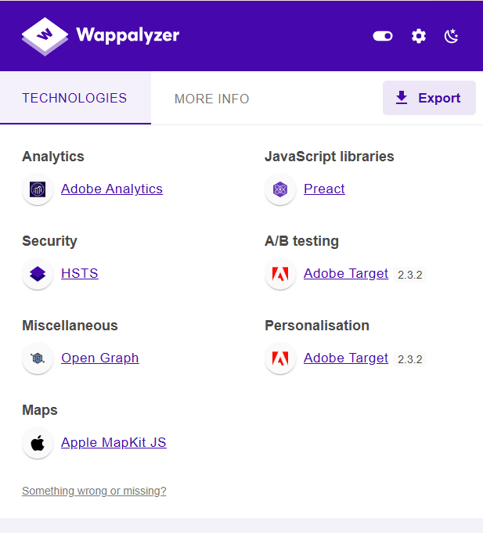
TASK-3- WEBSITE PLATFORM IDENTIFICATION
Platform
I have used Wappalyzer to identify the website flatform
There have used Adobe analytics for analytics
HSTS for security
Apple map kit JS for Maps
Preact for JavaScript libraries

Slide 6
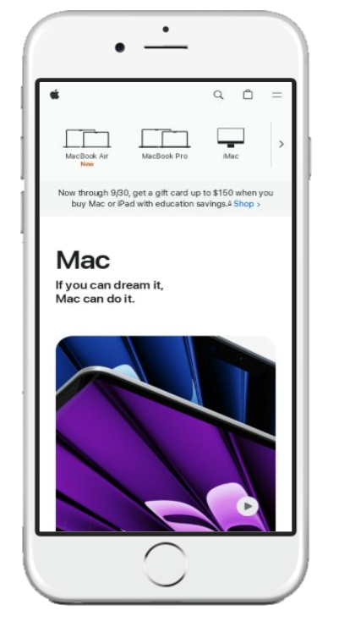
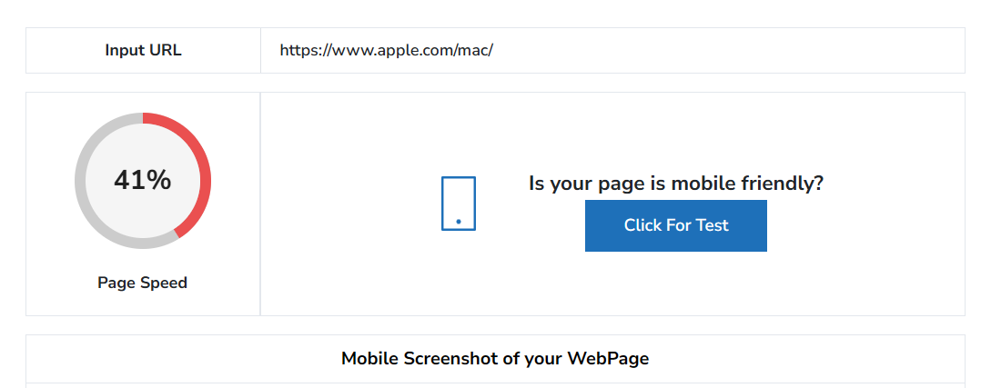
TASK-4-RESPONSIVE DESIGN TESTING Here I have used Mobile friendly test tool
Page-1- https://www.apple.com/mac/
This page is optimized properly on mobile and also user friendly too.
This website takes more time to load page.
The mac picture and tabs are visible in homepage itself

Slide 7
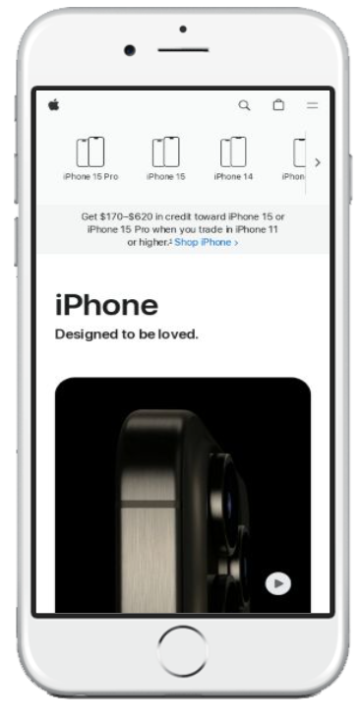
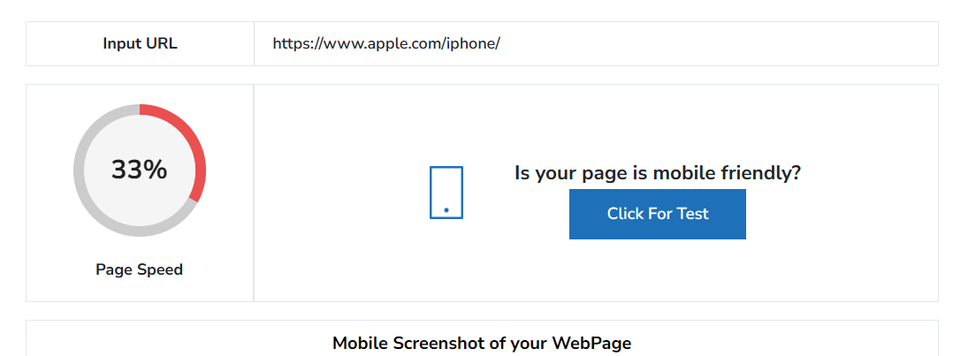
Page-2-https://www.apple.com/iphone/
This page is optimized properly on mobile
This website took more time to load
The iPhone new model and types of iphone’s are optimized in the homepage itself.

Slide 8
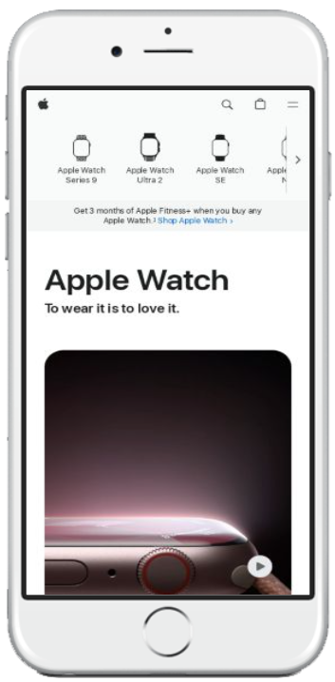
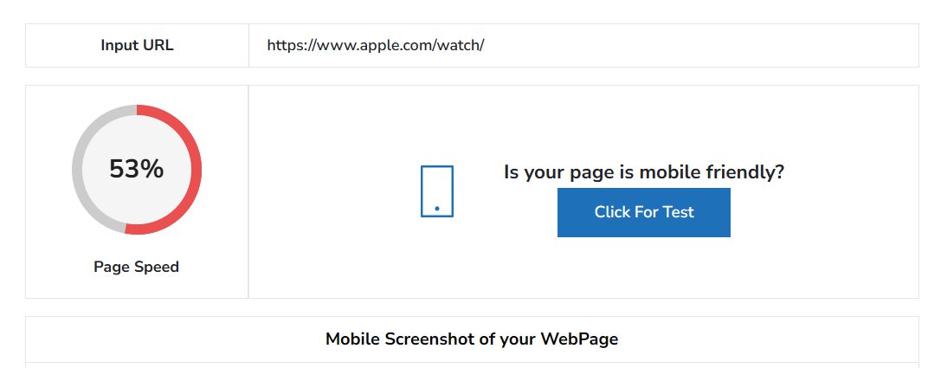
Page-3- https://www.apple.com/watch/
This page is optimized properly on mobile and also user friendly
The speed of this page is moderate
The watch picture, search tab and filters are visibling in the homepage.

Slide 9
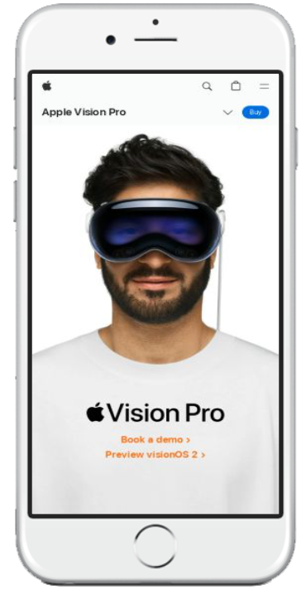
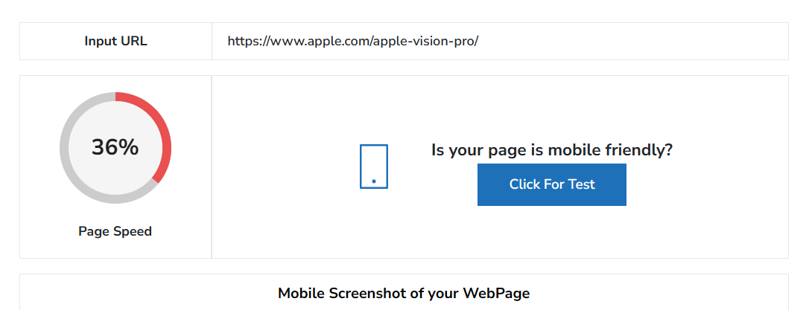
Page-4- https://www.apple.com/apple-vision-pro/
This page is perfectly optimized on mobile with the clear image of the product in homepage
But this website takes more time to load.

Slide 10
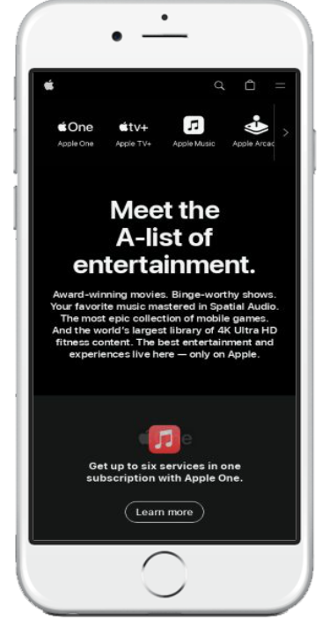

Page-5- https://www.apple.com/services/
This page is perfectly optimized on mobile with list of entertainments.
This website took more time to load page.

Slide 11
TASK-5-WEBSITE MISTAKES IDENTIFICATION
Mistakes:
Usage of Live images cause website loading speed.
Keywords and author of publish are missing in this website
Suggestions:
Emphasize a clean, minimalist design
Use high-resolution images and videos of Apple products to showcase their design and features.
Maintain a consistent color scheme and typography that aligns with Apple's brand image.
Include user reviews and ratings to provide social proof and help potential buyers make informed decisions.
Include a powerful search bar with filters
Offer instructional videos on using Apple products, including setup guides and tips for maximizing their features.
Maintain a blog or news section with updates on new Apple releases, software updates, and tips.

Slide 12
TASK-6-BEST PRACTICE LIST
Create a sense of openness and make content easier to read and navigate.
Include interactive demos or 360-degree views to allow users to explore products in detail.
Maintain consistency in font sizes and styles throughout the site.
Use drop-down menus or sidebars for additional options.
Use flexible grids and layouts that adapt to different screen sizes and orientations.
Animations and transitions are smooth and enhance the user experience without being distracting.
Use descriptive alt text for all images to improve accessibility for screen readers
Use appropriate meta tags and descriptions to enhance search engine results and encourage clicks.
Provide a clear privacy policy outlining how user data is collected, used, and protected.

Slide 13
TASK-7-LANDING PAGE DESIGN
I have chosen Canva to create a landing page for Apple.
Here’s the link for the landing page.
https://shans-apple.my.canva.site/

